Slide 1
One Forward Pass Per Turn
Playing a roguelike with a non-autoregressive decision brain —
typed judgments in ONE parallel pass. No LLM. No tokens. No text parsing.
Laya-Rogue · LayA decision matrix + HTN planner · repo: Irtechie/Laya-Rogue
Notes:
Pitch in one sentence: an 807 MB encoder answers SEVEN typed questions about a game state in one forward pass (~100 ms), and deterministic code decides what to do. Same typed-primitive pattern as the Jev DOOM demo — running locally, offline, for free.

Slide 2
THE SETUP
Agents today = a loop of LLM calls. It didn't have to be.
LLM agent text out, parse it, pray it's JSON; seconds per step; meter running; nondeterministic
Our agent (LayA) non-autoregressive encoder — it does NOT generate text; it answers typed questions
The primitive trio Choice (category), Score (scale), Noul (strict yes/no probability) — Jev-style
Why it can be fast one forward pass classifies ALL questions in parallel: ask 7 = cost of asking 1
Where it runs 807 MB checkpoint (model.safetensors, ~400M params) on a local GPU — $0 marginal cost
Notes:
Contrast: every LLM-agent failure mode (parse errors, hallucinated options, latency spikes, token bills) comes from generating text. We never generate text.

Slide 3
ARCHITECTURE
Two boxes, one HTTP port
GAME (browser)
RogueRNG + src/laya/ autopilot
policy · HTN planner · memory
BRIDGE (stdlib HTTP)
bridge/server.py + matrix.py
/decide /event /stats /schema
LayA CHECKPOINT
encoder on CUDA
1 pass ~100 ms · 0 LLM calls
⇄
→
// one tick, every ~110 ms (game/src/laya.js)
const f = facts(); // game -> structured JSON
const d = await askBridge(buildState(f)); // ONE forward pass -> 7 typed answers
plannerTick(f, d.decision); // HTN: noul axes arm long-horizon goals
const { act } = macroDecision(f, d.decision); // safety > plan > laya > reflex
game().core.act(act); // code owns the action, always
Notes:
The model NEVER acts. It votes. Everything around it is deterministic JS + stdlib python.

Slide 4
THE API — python bridge\demo.py
One call in. Seven typed answers out.
STATE dungeon crypts tier 2 | hp 11/42 | 3 monsters | 1 potion
MODEL 229 ms forward pass on cuda # 7 questions = 1 pass = 1 cost
intent choice -> explore conf 0.26
[explore 0.40 flee 0.21 cast 0.12 heal 0.06]
threat score -> 1.79 / 3 conf 0.04
hp_critical noul -> P(true) = 0.25
can_kill noul -> P(true) = 0.17
objective_reachable noul -> P(true) = 0.53
overmatched noul -> P(true) = 0.23
pack_needs_tending noul -> P(true) = 0.25
Typed no string parsing, no hallucinated JSON
Calibrated every answer carries a probability
Parallel 7 answers, same latency as 1
Notes:
Live output from the actual bridge. The state is unstructured JSON; the questions are declared once in matrix.py.

Slide 5
PRIMITIVE 1 OF 3 — CHOICE (closed-set decision)
Choice: pick one of 11 macro intents
bridge/matrix.py — the question
game/src/laya/policy.js — in-game use
"intent": Choice(
"What single move should the
adventurer make this turn?",
{ "fight": "strike a monster",
"cast": "attack spell in range",
"flee": "run for the stairs",
"heal": "drink a potion first",
"explore": "go deeper",
"loot": "grab the item",
... descend, ascend,
travel, errand, wait ...
})
// below the floor, a choice is noise
const intent = decision.confidence >= 0.15
? decision.intent : null;
if (intent === "flee")
return fleeAction(f); // "laya:flee"
if (intent === "fight" || intent === "cast") {
const a = bestAttack(f); // facts must allow it
if (a) return { act: a, why: "laya:" + intent };
}
Returns: chosen intent + confidence + the FULL 11-bar probability table (that's the distribution on the in-game panel and the dashboard).
Notes:
Key honesty trick: confidence floor 0.15. If the model isn't sure, the reflex layer plays instead — and the dashboard tracks who actually decided each turn.

Slide 6
PRIMITIVE 2 OF 3 — SCORE (ordered scale, can land between levels)
Score: how dangerous is this turn, 0 → 3
bridge/matrix.py — the question
game/src/laya/policy.js — in-game use
"threat": Score(
"How dangerous is this turn?",
[ "level 0: harmless",
"level 1: tense, not touching me",
"level 2: adjacent, could die soon",
"level 3: lethal, dying now" ])
// leaving the level needs BOTH the
// intent AND a near-lethal score
if (intent === "ascend"
&& decision.threat > 2.2)
return { act: { type: "ascend" },
why: "laya:ascend" };
A float on the scale, not an integer — 1.79 means "between tense and dangerous." Two typed signals must agree (choice + score) before the model can make the agent abandon the dive.
Notes:
Score can interpolate between anchor levels — like Jev's frustration score. Here it acts as a second, independent key that must turn together with the intent.

Slide 7
PRIMITIVE 3 OF 3 — NOUL (strict binary judgment)
Noul: P(true) for one yes/no question
bridge/matrix.py — 1 of 5 noul axes
game/src/laya/planner.js — in-game use
"pack_needs_tending": Noul(
"Should the adventurer go to town
soon to sell loot, identify gear,
buy supplies or turn in a quest?")
// a noul PROBABILITY arms an HTN goal
{ id: "tending", weight: 45,
trig: (f, d) =>
d.packNeedsTending > 0.75
&& f.mapKind === "dungeon"
&& (f.bag.length >= 10
|| f.gold >= 90),
tasks: tHomeDive }
Five noul axes: hp_critical, can_kill, objective_reachable, overmatched, pack_needs_tending. They are the model's own judgment used as SOFT PRECONDITIONS on long-horizon plans — e.g. overmatched > 0.7 triggers a flee the intent can't veto.
Notes:
This is the System-1 -> long-horizon bridge: a calibrated gut feeling, gated at 0.75, planning a multi-step town trip. No hardcoded threshold on HP/gold alone.

Slide 8
GUARDRAILS
The model votes. The code decides.
// priority is fixed, top wins (policy.js)
1 safety hp < 35% -> heal, else flee # no override
2 plan current HTN task (fight through it)
3 laya intent IF conf >= 0.15
AND facts say it's executable
4 reflex loot > fight > stairs > frontier
Facts gate "cast" with no mana in range → rejected, reflex plays
Safety first safety layer cannot be outvoted
Watchdog 15 ticks stuck → drop goal; 30 → ascend
Accountability every turn logs who decided: laya / safety / plan / macro
Notes:
This is why a near-chance zero-shot model is already playable: its wrong answers are filtered by facts, its right answers get through.

Slide 9
LONG HORIZON — HTN GOAL PLANNER
Three worries, one town trip
GOALS ARMED THIS TURN (facts + noul) MERGED PLAN (shared tasks once)
unpack bag 18/18 ─┐ 1 gohome
resupply 0 potions, 90 gold ├─► merge ──► 2 chores <- run ONCE
haveKey locked chest, no key ┘ 3 buy key
4 resume crypts:t2
Each goal = trigger + method (primitive tasks with done/act predicates). Active goals merge: duplicate tasks drop, the terminal "resume dive" is hoisted to the end. Three sequential chains would be 3 round trips; the planner makes it one. Dashboard shows the live plan per decision.
Notes:
This replaced 8 hardcoded event chains. The model's noul axes (packNeedsTending) are one of the goal triggers — perception layer feeding the planning layer.

Slide 10
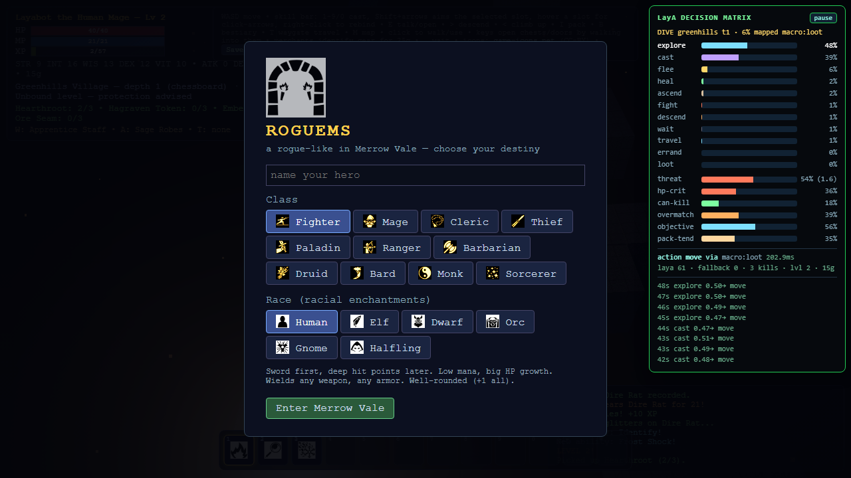
IT RUNS
45-second smoke run (headless, live bridge)
60 decisions 0 fallbacks — bridge answered every dungeon tick
3 kills while exploring + looting; 0 deaths
0 stalls, 0 page errors goal commitment + watchdog never tripped
Panel visible right full intent distribution + 5 noul axes, live
Longer runs full chain loop verified: locked chest -> buy key -> potions -> quest -> descend
Notes:
Pilot-e2e.mjs is reproducible: PILOT_MINUTES=480 for overnight runs, JSONL telemetry -> dashboard at :8732.

Slide 11
HONESTY & WHAT'S NEXT
Zero-shot today — and the dashboard proves it
Near chance today base checkpoint: intent conf ~0.3-0.5; gates + reflex carry the play
Honesty table dashboard tracks the share of turns where laya:* actually earned execution
Next: RLCD fine-tune train on game-state labels -> noul axes become CALIBRATED preconditions
Then hand over the wheel as conf rises, the floor drops and laya share grows — measured, not assumed
The pitch a $0-per-turn agent brain: ~100 ms, local, deterministic guardrails, typed answers
Notes:
Close on trust: we don't claim the model plays well yet — we show the machinery that makes every improvement measurable and every bad prediction harmless.

Slide 12
Ask seven questions. Pay one forward pass.
game + bridge + dashboard + planner: github.com/Irtechie/Laya-Rogue
demo: python bridge\demo.py · dashboard: http://localhost:8732 · press P in game
Notes:
End with the demo loop running on the dashboard if time allows.

